Slide 1

Computer Networks
BCSC0008
Shabir Ali

Slide 2
What is computer network
A network can be defined as two or more computers connected together in such a way that they can share resources.
Computer network connects two or more autonomous computers.
The computers can be geographically located anywhere.
The connecting medium could be wired or wireless.
The purpose of a network is to share resources.

Slide 3
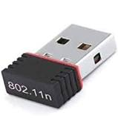
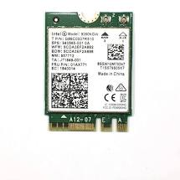
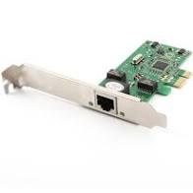
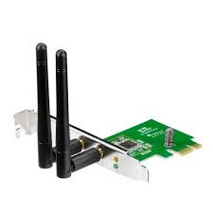
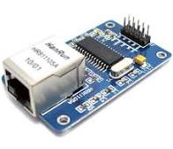
Network Interface Card

Slide 4
Advantages of networking
Connectivity and Communication
Data Sharing
Hardware Sharing
Internet Access
Internet Access Sharing
Performance Enhancement and Balancing
Entertainment

Slide 5
The Disadvantages (Costs) of Networking
Network Hardware, Software and Setup Costs
Hardware and Software Management and Administration Costs
Undesirable Sharing
Illegal or Undesirable Behavior
Data Security Concerns

Slide 6

What’s the Internet: “nuts and bolts” view
PC
millions of connected computing devices: hosts = end systems
running network apps
Mobile network
server
Global ISP
wireless
laptop
cellular
handheld
Home network
communication links
fiber, copper, radio, satellite
transmission rate = bandwidth
Regional ISP
access
points
Institutional network
wired
links
routers: forward packets (chunks of data)
router
Notes:
6

Slide 7
What’s the Internet: “nuts and bolts” view
protocols control sending, receiving of msgs
e.g., TCP, IP, HTTP, Skype, Ethernet
Internet: “network of networks”
loosely hierarchical
public Internet versus private intranet
Internet standards
RFC: Request for comments
IETF: Internet Engineering Task Force
Mobile network
Global ISP
Home network
Regional ISP
Institutional network
Notes:
7

Slide 8
What’s the Internet: a service view
communication infrastructure enables distributed applications:
Web, VoIP, email, games, e-commerce, file sharing
communication services provided to apps:
reliable data delivery from source to destination
“best effort” (unreliable) data delivery
Notes:
8

Slide 9
What’s a protocol?
human protocols:
“what’s the time?”
“I have a question”
introductions
… specific msgs sent
… specific actions taken when msgs received, or other events
network protocols:
machines rather than humans
all communication activity in Internet governed by protocols
protocols define format, order of msgs sent and received among network entities, and actions taken on msg transmission, receipt
Notes:
9

Slide 10


What’s a protocol?
a human protocol and a computer network protocol:
Hi
TCP connection
request
Hi
TCP connection
response
Got the
time?
Get http://www.awl.com/kurose-ross
2:00
<file>
time
Q: Other human protocols?
Notes:
10

Slide 11
Internet protocol stack
application: supporting network applications
FTP, SMTP, HTTP
transport: process-process data transfer
TCP, UDP
network: routing of datagrams from source to destination
IP, routing protocols
link: data transfer between neighboring network elements
Ethernet, 802.111 (WiFi), PPP
physical: bits “on the wire”
application
transport
network
link
physical
Notes:
11

Slide 12
ISO/OSI reference model
presentation: allow applications to interpret meaning of data, e.g., encryption, compression, machine-specific conventions
session: synchronization, checkpointing, recovery of data exchange
Internet stack “missing” these layers!
these services, if needed, must be implemented in application
needed?
application
presentation
session
transport
network
link
physical
Notes:
12

Slide 13
Why layering?
Dealing with complex systems:
explicit structure allows identification, relationship of complex system’s pieces
layered reference model for discussion
modularization eases maintenance, updating of system
change of implementation of layer’s service transparent to rest of system
Notes:
13

Slide 14
Objectives of This Course
The objective is to understand fundamental underlying principles of computer networking, details and functionality of layered network architecture.

Slide 15
Outcome of this Course
Understand the terminology and concepts of the OSI reference model and the TCP/IP Protocol stack.
Apply the concepts of protocols, network interfaces, and design/performance issues in local area networks and wide area networks.

Slide 16
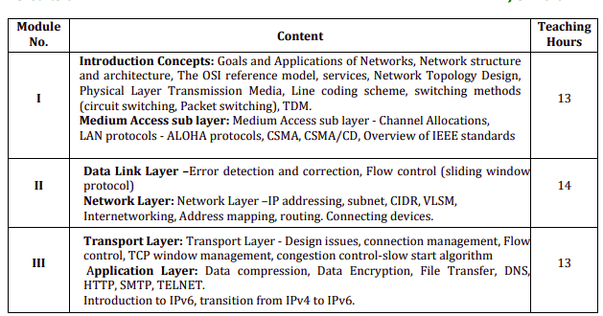
Course Overview

Slide 17
Reference Books
Forouzan B. A. (2004), “Data Communication and Networking”, 4th Edition, McGrawHill.
Kurose, J.F. and Ross K.W. (2005), “Computer Networking: A Top-Down Approach Featuring the Internet”, 3rd Edition, Addison-Wesley.
A.S.Tanenbaum (2006), “Computer Networks”, 2nd Edition, Prentice Hall India.

